Slide 1
IT APPLICATION ICA2
Alex, Felix, Ken & Clifton

Slide 2
Table of contents
01
02
03
04
Problem Statement
Background
What exactly is the situation?
Details about the issue we are solving.
Business needs
The Game
What needs are we fulfilling?
What exactly is our game about?

Slide 3
Problem Statement
What exactly is the situation?

Slide 4
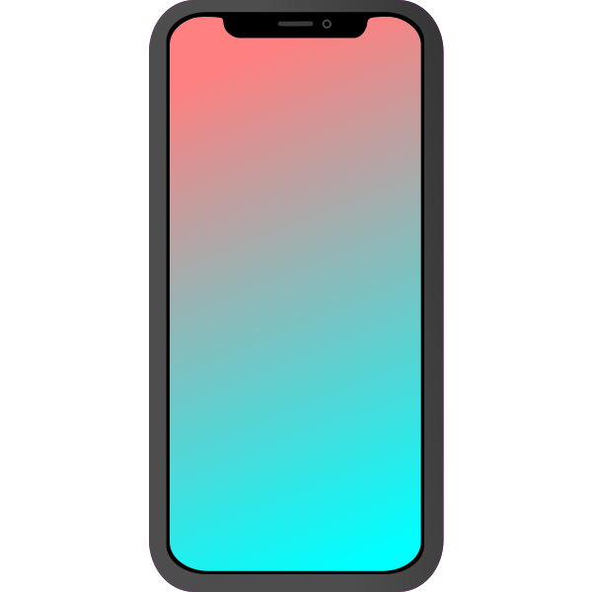

Problem Statement
Social media addiction poses a risk for everyone, especially primary school children with unlimited access. To address this, we target tuition centres where parents often drop off their children early who then indulge in their mobile devices. This poses several negative impacts to them.

Slide 5
Background
Details about the issue we are solving.

Slide 6

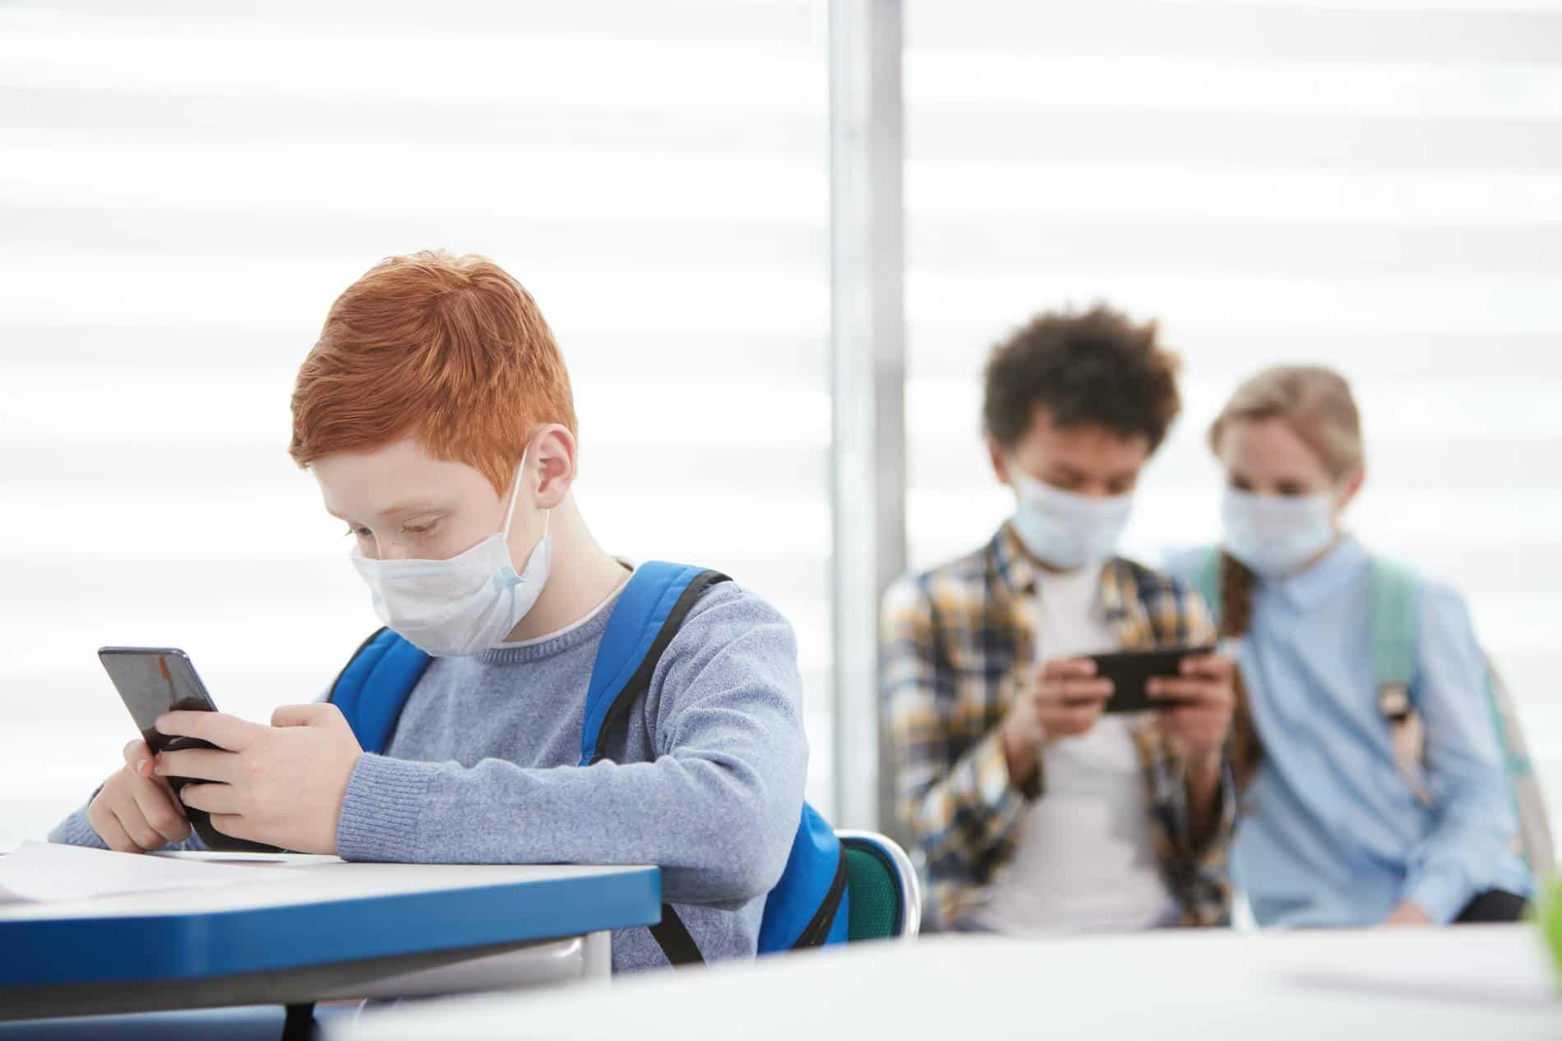
Background
Students engrossed with their mobile phones
Social media (Instagram, Whatsapp)
Primary school students
Excessive social media usage (unlimited access)
Potential negative effect
-Distraction from schoolwork (time & attention spent)
-Child’s sleep patterns

Slide 7
Business Needs
What needs are we fulfilling?

Slide 8
4 Main Business Needs
Improve students’ mental sum and their hand eye coordination
Allow parents and their kids to bond by playing the game at the tuition
Encourage students to be productive before tuition starts
Keeping students happy so that they will stay with the tuition center for longer, hence increasing number of tuition students and increasing profit

Slide 9

First Business Need
Improve students’ mental sum and their hand eye coordination
Playing the game
Quickly solve problems
Need to move the rocket quickly
Applies to academics and personal life
Solve problems faster
Play sports better

Slide 10

Second Business Need
Allow parents and their kids to bond by playing the game at the tuition
Most parents
Leave
Wait until lessons start
Playing the game
Parents and kids can bond
Make going to tuition fun

Slide 11

Third Business Need
Encourage students to be productive before tuition starts
Come early
Pass time
Use phone
Playing the game
Warm up for lessons
Be more productive

Slide 12


Fourth Business Need
Keeping students happy so that they will stay with the tuition center for longer, hence increasing number of tuition students and increasing profit
Game increases students’ happiness
Stay longer
Increase Profits
Paying tuition fees for longer
More parents will recommend
Increasing no. of students
More parents paying

Slide 13
THE GAME

Slide 14



The Game
You are an astronaut traversing a dense asteroid field and you have to help him solve math to get him back home
Dodge asteroids to avoid damaging your ship and Help him crack the codes to see which asteroids are safe.
Game ends if lives hit zero
Get 1 point per minute survived
Wrong answers will also damage you

Slide 15
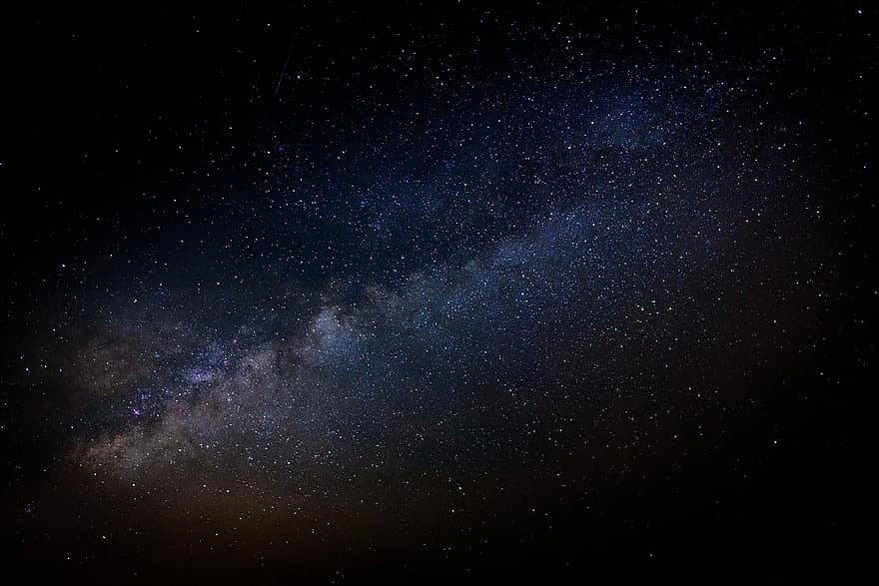




16
10+6?
17

Slide 16
16
10+6?
17

Slide 17

16
10+6?
17

Slide 18
10+6?
16
17

Slide 19
10+6?
16
17

Slide 20
10+6?
17

Slide 21
10+6?
17

Slide 22

GAME OVER
Your score:8

Slide 23
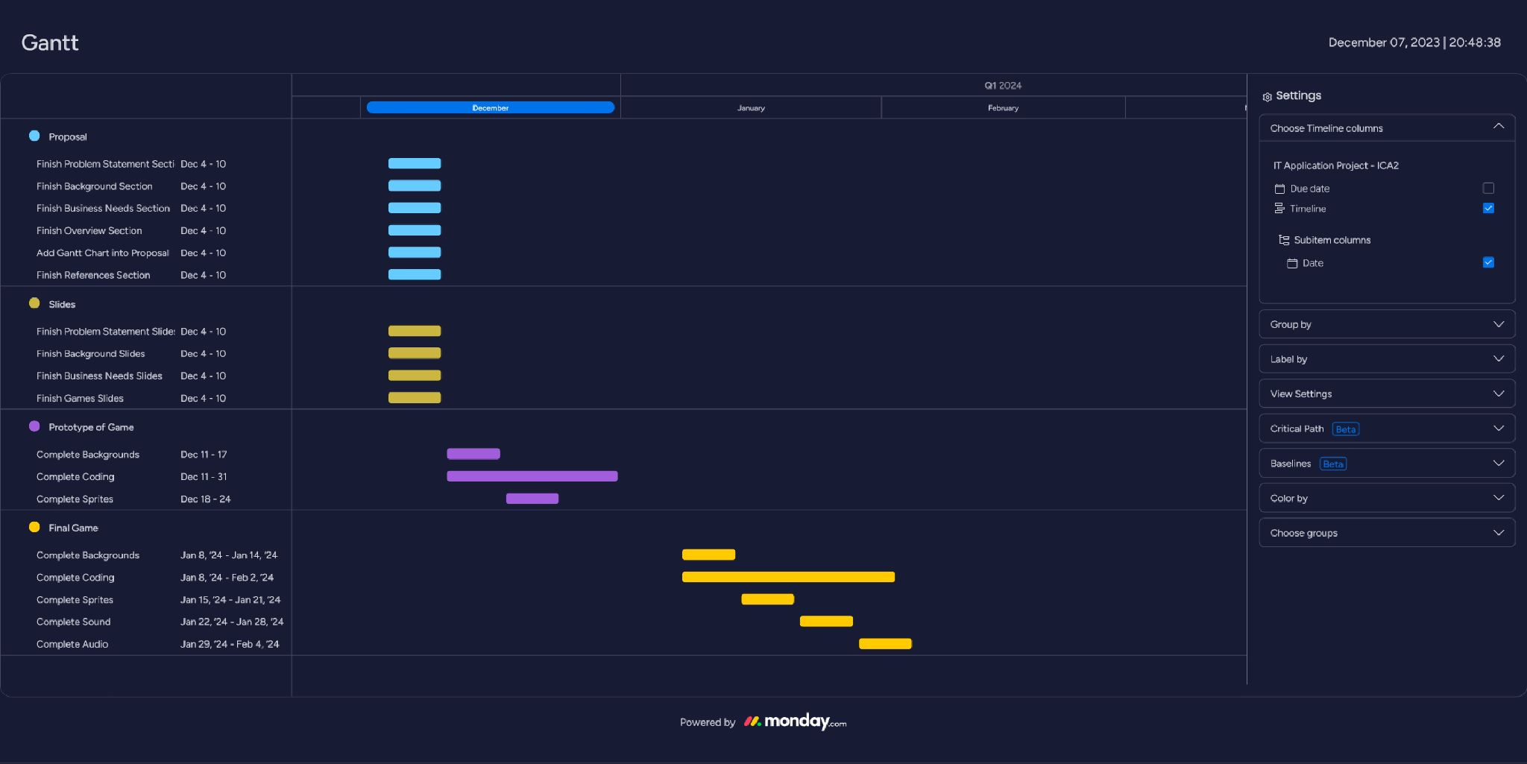
Gantt Chart

Slide 24
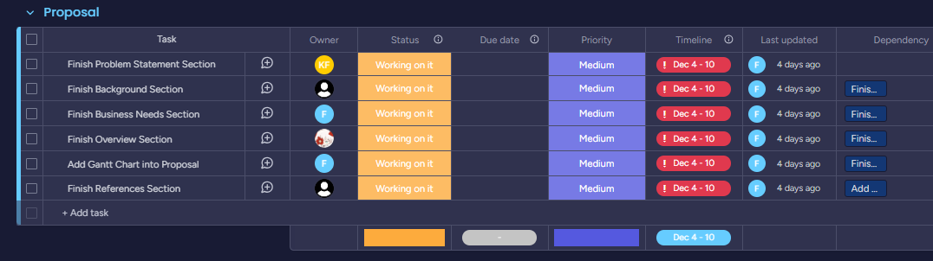
Task Allocation

Slide 25
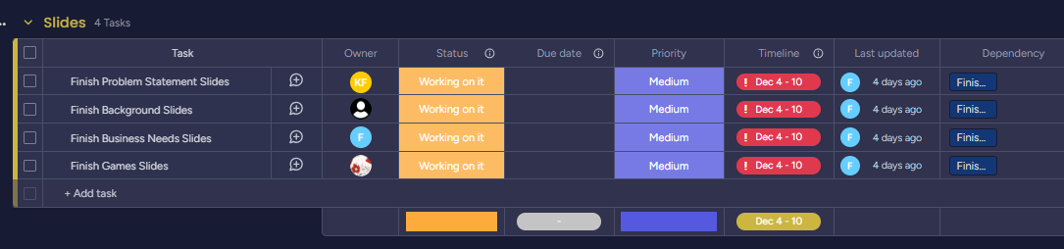
Task Allocation

Slide 26
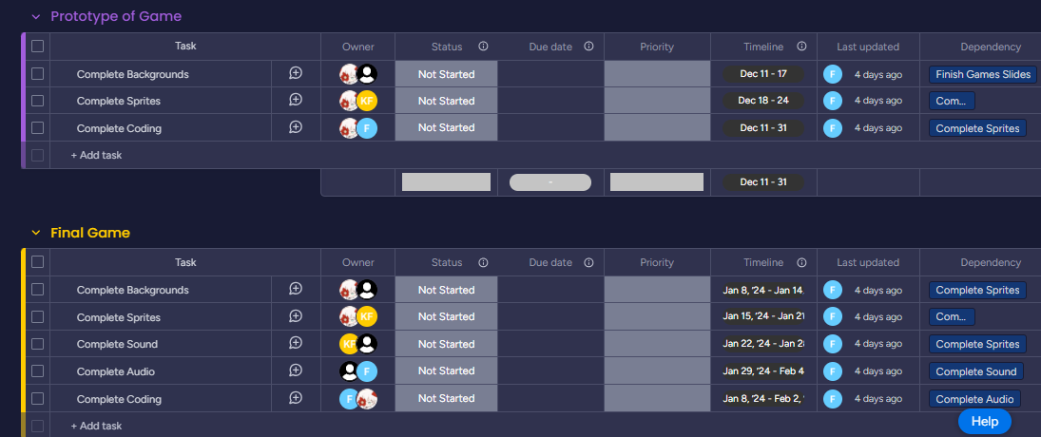
Task Allocation

Slide 27
References
Kids Are Using Social Media More Than Ever, Study Finds - The New York Times (nytimes.com)

Slide 28
Thank you

